Slide 1



———
STUDENT
MENTAL
HEALTH
———
Project 4
Alyssa, Patrick, Nathan, Alexia

Slide 2


PROPOSAL/INTRODUCTION
For our project we decided to focus our data on Student Mental Health.
We wanted our model to be able to predict depression on a student and were able to get it at 84%.
Depression is the most common mental illness and it greatly impacts many people and we were interested in finding more details.

Slide 3

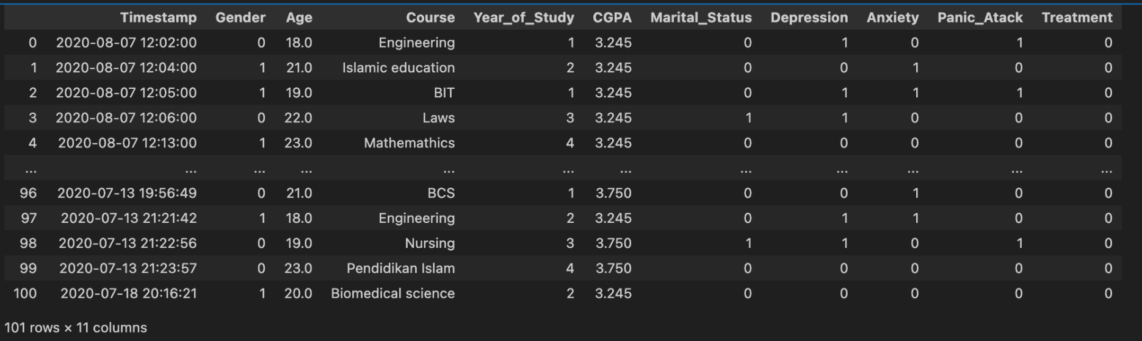
Dataset had 10 columns and 100 rows.
There were mental illness for Depression, Anxiety, and Panic Attack.
We decided to stay focused on Depression for our prediction.
Dataset found on Kaggle - Student Mental Health
Url: https://www.kaggle.com/datasets/shariful07/student-mental-health/data

Slide 4
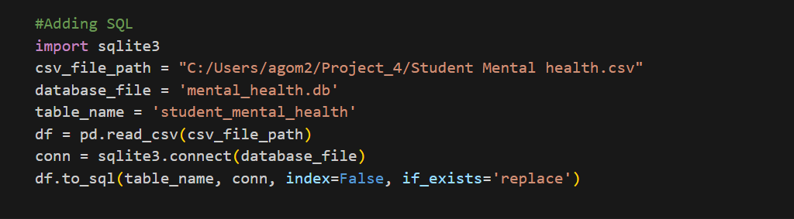
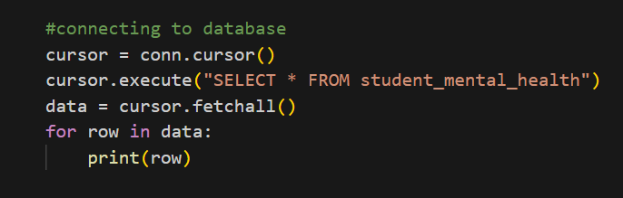
Data Model Implementation - SQL

Slide 5

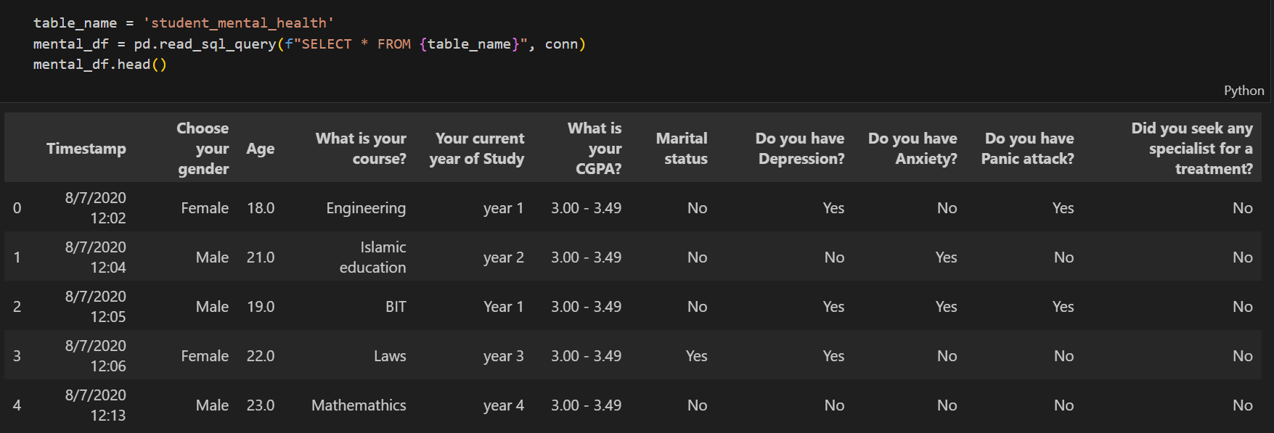
SQL TABLE

Slide 6
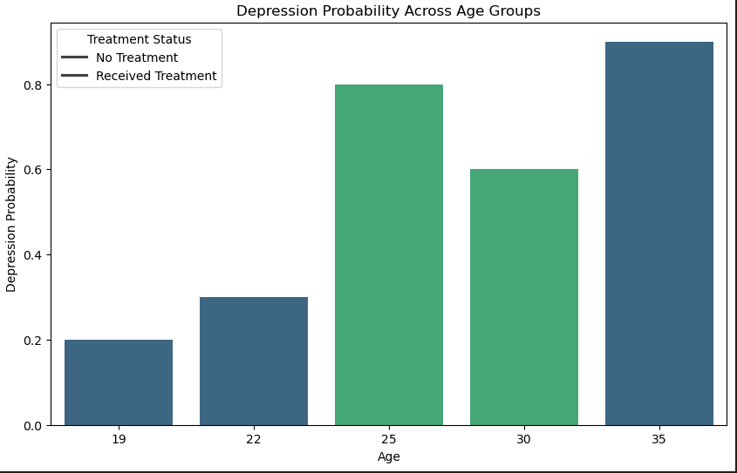
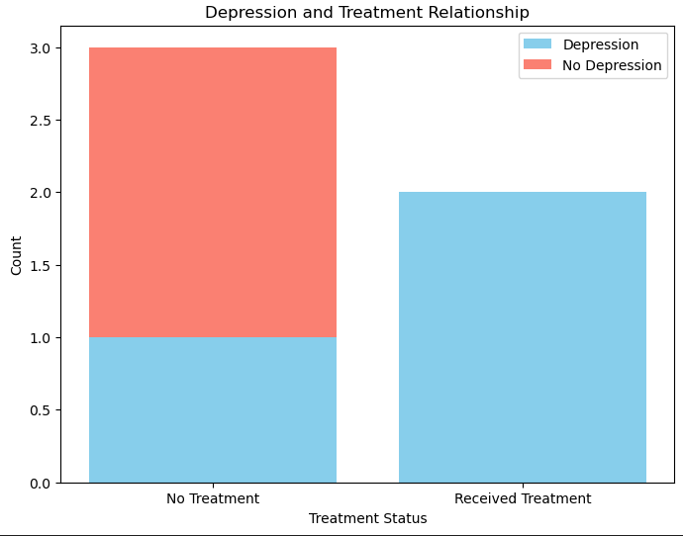
Visualization

Slide 7
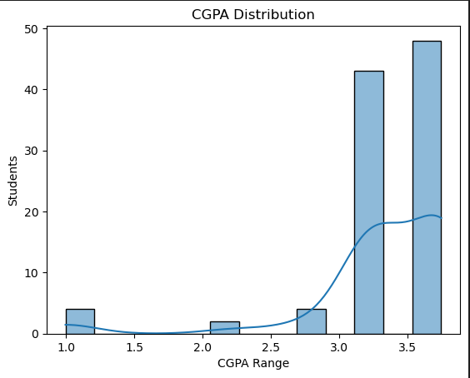
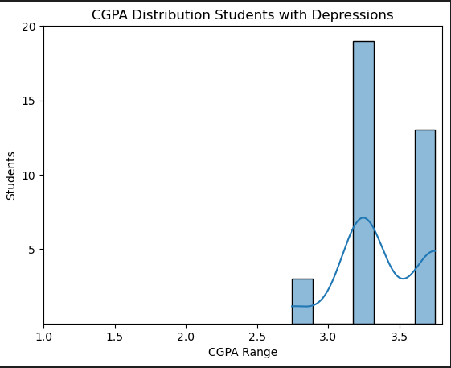

Slide 8

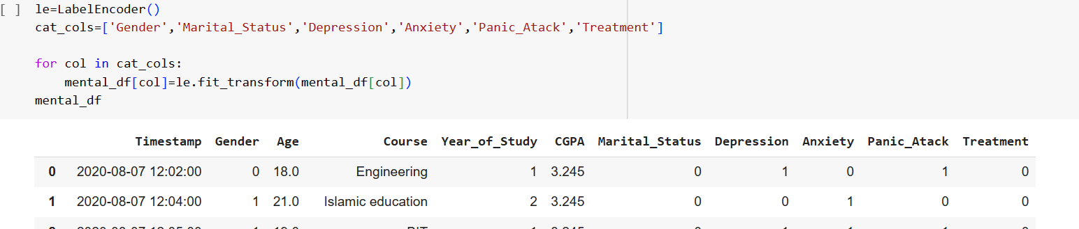
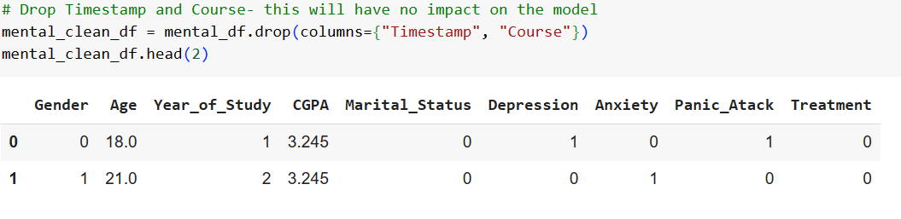
Machine Model

Slide 9

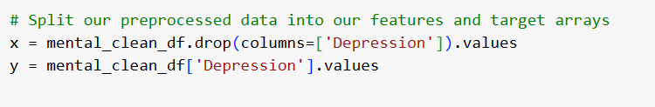
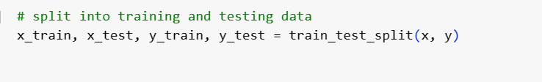
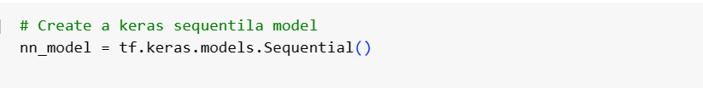

Slide 10

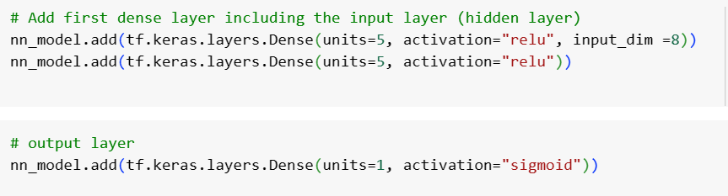
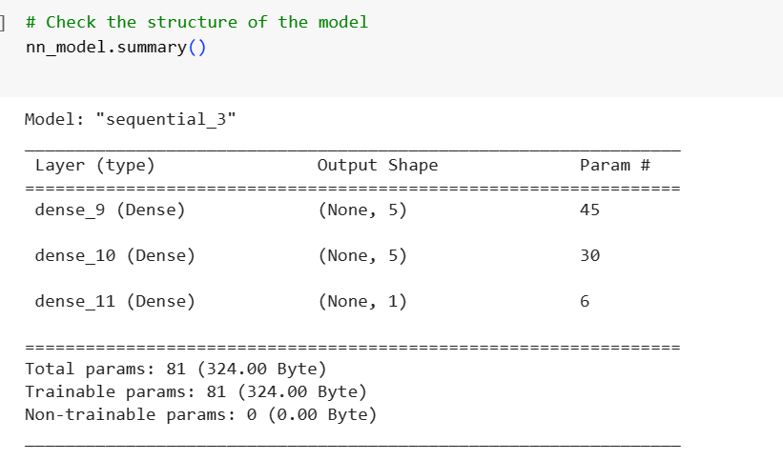

Slide 11

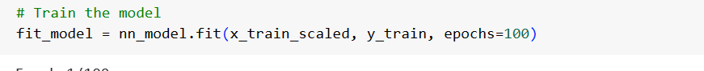
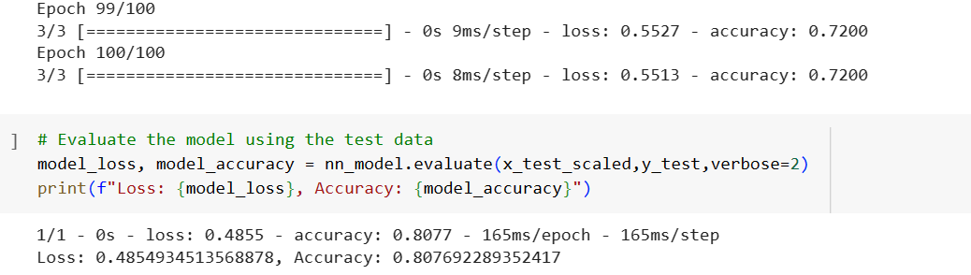
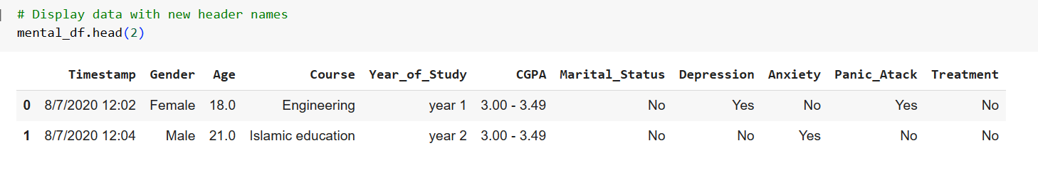

Slide 12

Limitations
Based on the data we were able to find on Kaggle we did get quick results due to it being a small data set.
For the future we would like to work with a larger data set to be able to find more details and more columns of different topics.
Next time we would like to look into several mental illness and find more details on all of them instead of just one.

Slide 13


Conclusion: Our model was able to predict with 84% accuracy if a student had depression. We were able to see how depression could affect a students gpa.
Based on our data and what we were able to gather we can see the effects on depression do impact a students ability to perform in school.
Though there is factors on whether a student gets treated for the illness or not, the age, gender, years of study, and type of courses, it does create an effect and can damage their ability to perform in school.

